Slide 1

Kettlebell: Revolutionizing Gym Management
A smart platform enabling personalized fitness, streamlined trainer-member communication, and centralized data for smarter goals.
Course: CSE 327
Team : SatoriX
Supervisor: ITN
Date: 12 oct, 2025

Slide 2

Problem Statement
Modern gyms face challenges in managing trainers, members, and personalizing fitness plans. Trainers struggle to track progress, and members receive generic plans. There’s a lack of centralized digital management.

Slide 3

Elevator Pitch
Kettlebell is a digital gym management platform connecting gyms, trainers, and members.
It allows trainers to assign workouts, diets, and review member videos.
Gyms manage members and trainers efficiently with smooth experience.

Slide 4
Business Model: Gym Subscriptions
Basic Software: Standard platform with all the available features.
Starts at 500000 BDT/year
01
Customized Plan: Branding, custromized dashboard & analytics.
Starts at 700000 BDT/year
02

Slide 5
Target Users
• Gym Owners – Manage gym operations
• Trainers – Assign routines & track progress
• Members – Get personalized plans and feedback

Slide 6
Business Model- User Subscriptions
/
Basic: Trainer-assigned workouts.
Starts from 2000 BDT/month
01
Medium: Includes diet and weekly feedback.
Starts from 4000 BDT/month
02
Premium: Analytics and full trainer access with hand-to-hand assistance.
Starts from 15000 BDT/month
03

Slide 7
Objectives
1. Digitalize gym management
2. Personalize fitness & diet plans
3. Enable trainer–member communication
4. Provide progress tracking
5. Support multi-gym scalability

Slide 8
Project Scope
In Scope:
• Gym registration & dashboard
• Trainer-member management
• Personalized diet & exercise
• Video upload & feedback
Out of Scope:
• AI recommendation system
• Payment management

Slide 9
Risks & Mitigation
• Data privacy breaches – Use encryption & authentication
• Server downtime – Cloud hosting
• Low adoption – Simple UX design
• Feature complexity – Incremental modules

Slide 10
Proposed Solution
Kettlebell bridges gyms, trainers & members with smart tools:
• Personalized plans
• Trainer feedback via video
• Centralized data & reports
• Transparent performance tracking

Slide 11

Sample Problem & Solution
Problem:
Member lacks form feedback.
Solution:
Member uploads video → Trainer reviews → Provides feedback → Member improves performance.

Slide 12
Functional Requirements
1. Gym registration
2. Trainer plan assignment
3. Member routine viewing
4. Video upload for feedback
5. Trainer-member chat
6. Attendance tracking
7. Progress reports

Slide 13
Non-Functional Requirements
1. Handle 500+ concurrent users
2. Response < 3s
3. 99% uptime with cloud redundancy

Slide 14
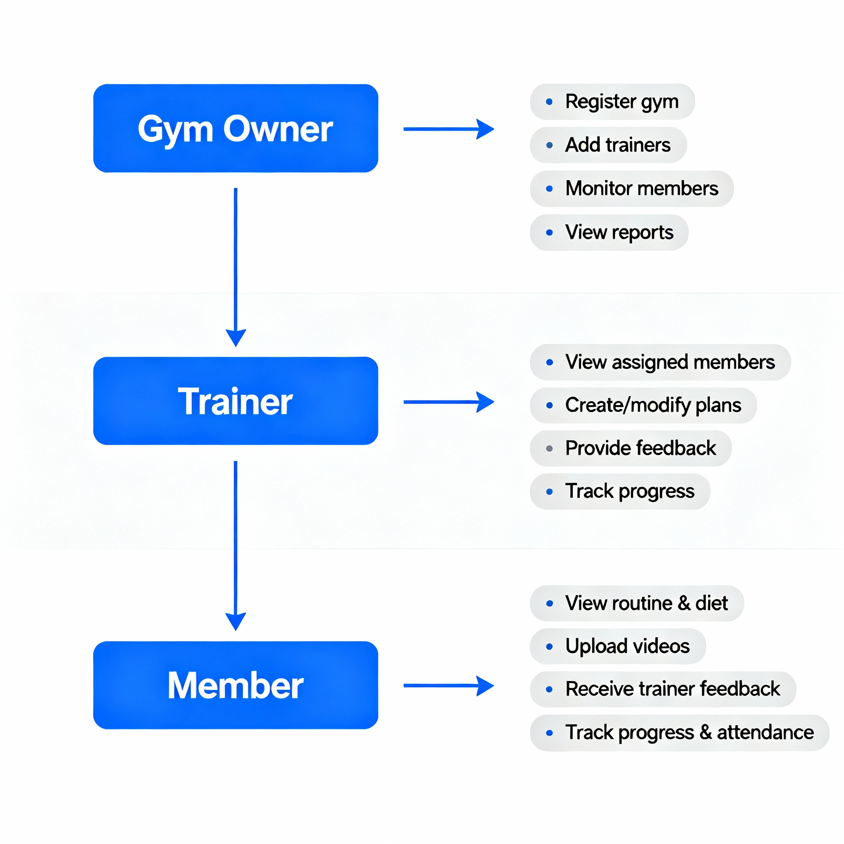
Role-Wise Features Diagram

Slide 15

User Story 1
As a member, I want to upload videos so my trainer can correct my posture.
Acceptance Criteria:
• Upload ≤200MB
• Trainer can comment & rate
• Notification sent upon feedback

Slide 16

User Story 2
As a trainer, I want to assign custom diets and exercises.
Acceptance Criteria:
• Select templates or create plans
• Member notified instantly
• Appears on dashboard

Slide 17

User Story 3
As a gym owner, I want analytics to evaluate trainer performance.
Acceptance Criteria:
• Reports with charts
• Filter by trainer/date
• Export PDF/CSV

Slide 18
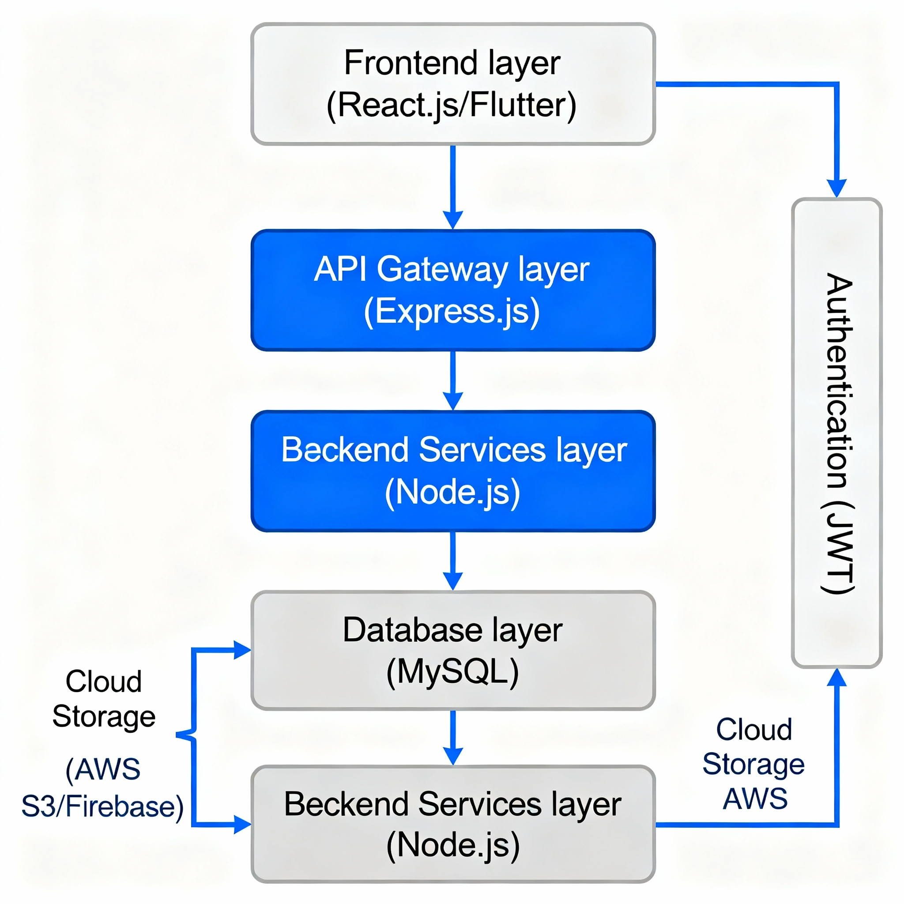
A high-level software diagram

Slide 19

Technology Stack
Frontend: React.js / Flutter
Backend: Node.js (Express)
Database: MongoDB
Cloud: Vercel / netlify
Auth: Firebase
Version Control: GitHub

Slide 20
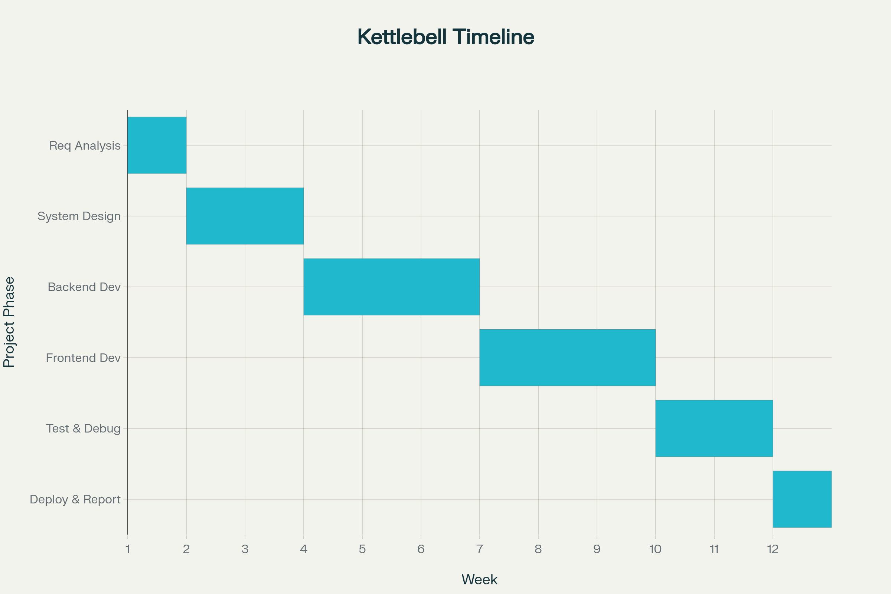
Gantt Chart
Week 1: Requirements
Week 2-3: Design
Week 4-6: Backend Dev
Week 7-9: Frontend Dev
Week 10-11: Testing
Week 12: Deployment

Slide 21
Work Distribution
Tasnif Gaffar Pronoy: Frontend and design UI,UX.
Mehedi Hasan siam: Backend and Database.
Sabbir Ahmed: QA and Testing.
Farhan sadik arnob: Documentation and deployment.

Slide 22
References:
• Mindbody App
• Virtuagym

Slide 23

Novelty:
• Multi-gym platform
• Video posture feedback
• Analytics dashboard
• Future AI integration

Slide 24

Conclusion
Kettlebell transforms traditional gym management into a smart, interactive ecosystem for gyms, trainers, and members with personalization and accountability.

